Slide 1

Java for Beginners
British School of Beijing
Mr. Teasdale

Slide 2
Levels of Java coding
1: Syntax, laws, variables, output
2: Input, calculations, String manipulation
3: Selection (IF-ELSE)
4: Iteration/Loops (FOR/WHILE)
5: Complex algorithms
6: Arrays
7: File management
8: Methods
9: Objects and classes
10: Graphical user interface elements

Slide 3
Methods
Methods are smaller chunks of code that perform a specific function that you might want to repeat in future
Method rules:
Starts with a lower case letter
Ends with a set of brackets: ( )
Has to say what comes back

Slide 4
Types of methods
Methods that return a value are called return type methods.
You have to specify what type of data is being returned: int, String, char, etc.
Methods that don’t return a value are called void methods.
Some people call void methods procedures and return type methods functions

Slide 5
Summary
Void methods
Don’t return a value
Called procedures
Return methods
Returns a specified value
Called functions

Slide 6
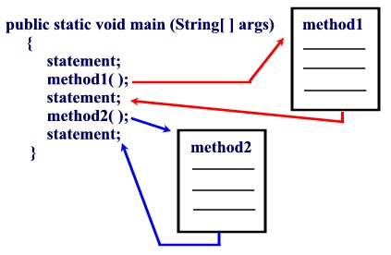
Methods are called from within the ‘main method’

Slide 7
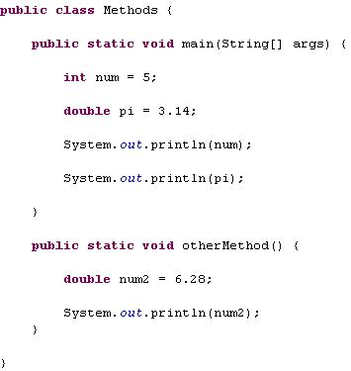
They are normally written below the main method (but it really doesn’t matter)

Slide 8
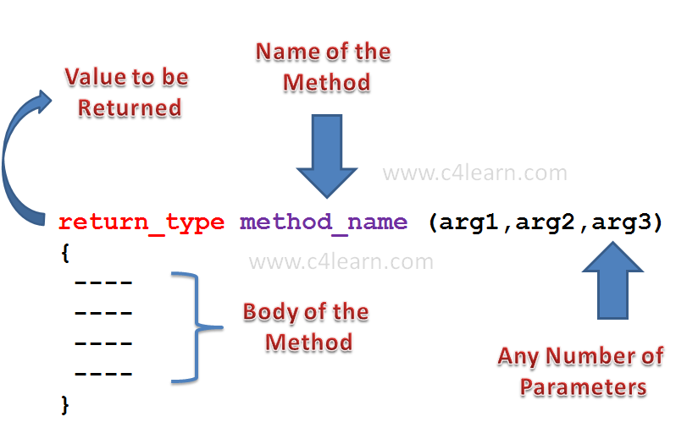
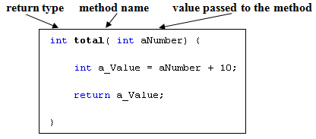

Slide 9
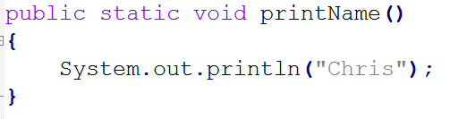
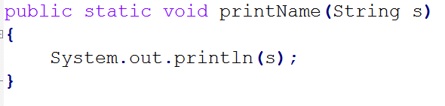
Void method examples

Slide 10
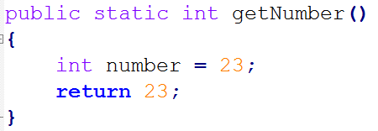
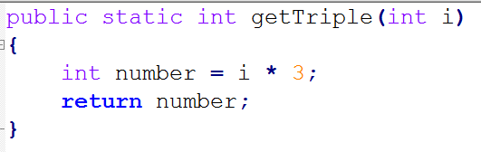
Return method examples

Slide 11
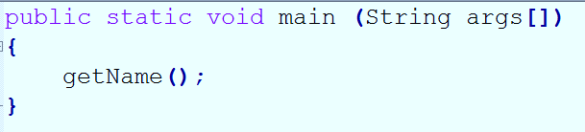
Void methods can be called on their own line

Slide 12
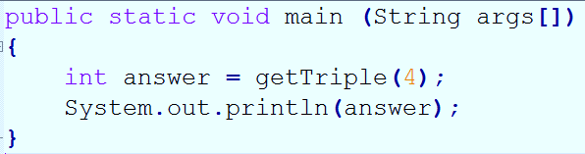
Return methods should be called into a receiving container

Slide 13
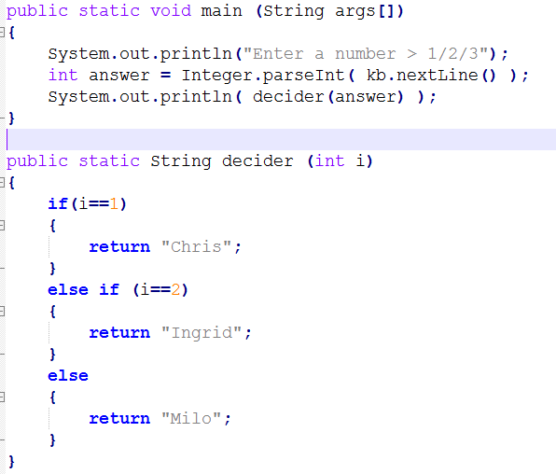
Common example
What does this code segment do?
How does it do it?

Slide 14
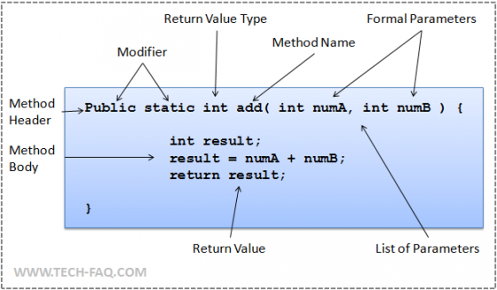
Method summary

Slide 15
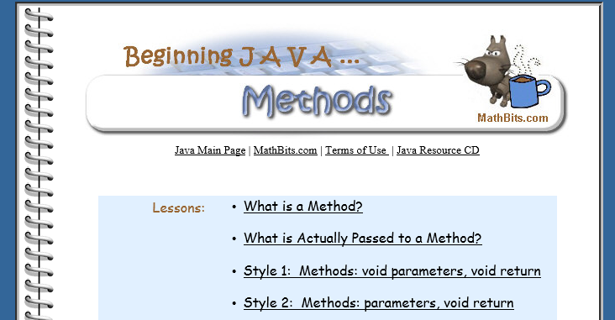
Useful resource #1
http://mathbits.com/MathBits/Java/Methods/methods.htm

